Slide 1
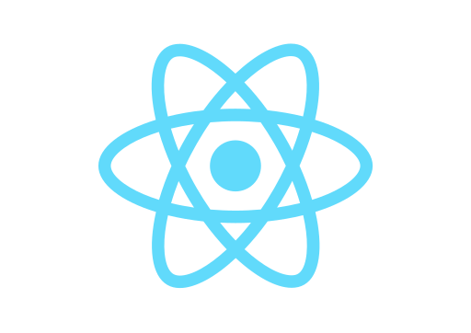

React & Heroku
Deploy React App to Heroku

Slide 2
Heroku is a container-based cloud Platform as a Service (PaaS). Developers use Heroku to deploy, manage, and scale modern apps. This platform is elegant, flexible, and easy to use, offering developers the simplest path to getting their apps to market.
First, you have to create account on heroku.com!

Slide 3
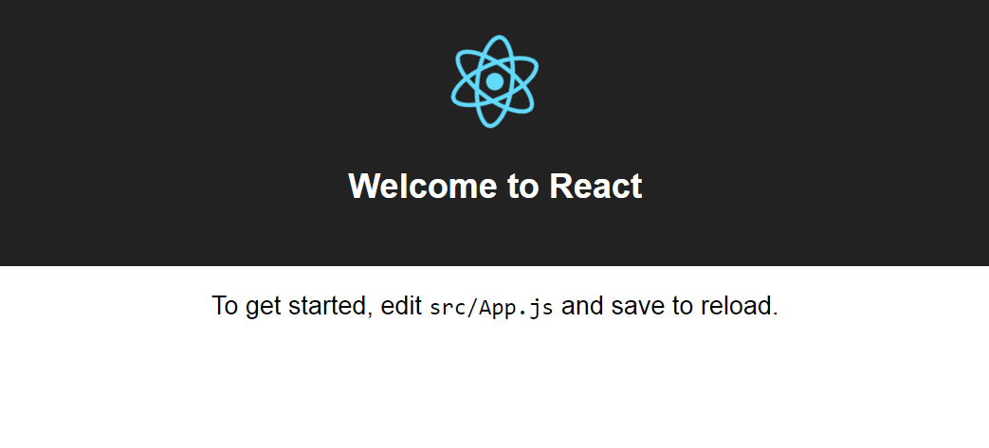
https://arcane-shore-19931.herokuapp.com/

Slide 4
#1 Create/Prepare Your React App
Install create-react-app utility globally on your PC (if you have not done yet before)
$ npm install -g create-react-app
Create a new react app or prepare yours
$ create-react-app linya
$ cd linya
Make sure that it runs successfully
$ npm start

Slide 5
#2 Install Heroku CLI
Heroku Command Line Interface is built with Node.js and is installable via npm. Install Heroku CLI globally
$ npm install -g heroku
Check Heroku CLI version
$ heroku --version
Login to Heroku (input email & password)
$ heroku login

Slide 6
#3 Create Git Repo & Heroku Project
Create git repo locally
$ git init
Create Heroku project with create-react-app buildpack specified
$ heroku create -b https://github.com/mars/create-react-app-buildpack.git
If you have not logged in yet, you have to input your Heroku email & password first!

Slide 7
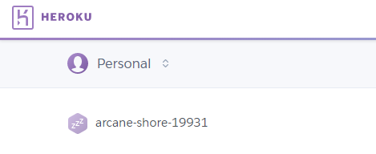
#4 Push Your Project
Push your project to Heroku
$ git add .
$ git commit -m "deploy ke Heroku"
$ git push heroku master
$ heroku open
All Done! After $ heroku open it will automatically open your online project on web browser.

Slide 8
https://arcane-shore-19931.herokuapp.com/

Slide 9
React & Heroku
Deploy React App to Heroku

